Slide 1

Customer Shopping Behavior Analysis
This project delves into customer shopping behavior using transactional data from 3,900 purchases. Our primary objective is to uncover actionable insights into spending patterns, customer segmentation, product preferences, and subscription behavior. These insights are crucial for guiding strategic business decisions and optimizing marketing efforts.
By leveraging a comprehensive dataset and employing a multi-faceted analytical approach, we aim to provide a clear understanding of our customer base and identify opportunities for growth and improvement.

Slide 2

Dataset Overview: Unpacking the Data
Project Overview
Dataset Summary
Our analysis is built upon a rich dataset comprising 3,900 individual purchase records. This extensive data allows for a granular examination of various aspects of customer interactions, from initial product selection to final purchase and beyond.
Rows: 3,900
Columns: 18
Key Features: Customer demographics (Age, Gender, Location, Subscription Status), Purchase details (Item Purchased, Category, Purchase Amount, Season, Size, Color), Shopping behavior (Discount Applied, Promo Code Used, Previous Purchases, Frequency of Purchases, Review Rating, Shipping Type).
Missing Data: 37 values in the 'Review Rating' column, which were addressed during data cleaning.
The goal is to transform raw transactional data into strategic intelligence, enabling more informed decision-making across the business.

Slide 3
Exploratory Data Analysis with Python
Our analytical journey began with robust data preparation and cleaning using Python, ensuring the integrity and usability of our dataset.
1
2
3
Data Loading
Initial Exploration
Missing Data Handling
The dataset was efficiently imported into our environment using the pandas library, a cornerstone for data manipulation in Python.
We utilized df.info() to understand the data structure and .describe() to obtain summary statistics, providing a foundational view of the dataset's characteristics.
Null values were identified, and missing entries in the 'Review Rating' column were imputed using the median rating specific to each product category, maintaining data accuracy.
4
5
6
Column Standardization
Feature Engineering
Data Consistency Check
Columns were renamed to 'snake_case' for enhanced readability and consistency, improving documentation and ease of access for future analyses.
New features such as age_group (by binning customer ages) and purchase_frequency_days (derived from purchase data) were created to enrich our analytical capabilities.
A thorough check for redundancy between discount_applied and promo_code_used led to the dropping of promo_code_used, streamlining the dataset.
7
Database Integration
The cleaned DataFrame was seamlessly connected to a PostgreSQL database, preparing it for advanced SQL-based analysis.

Slide 4
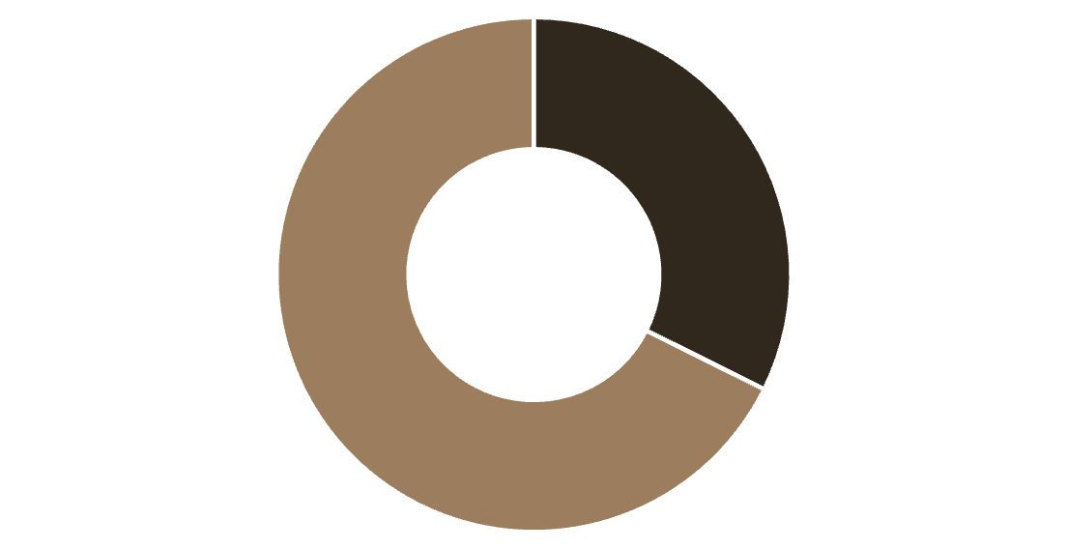

Data Analysis with SQL: Key Business Questions
Structured analysis in PostgreSQL provided answers to critical business questions, offering a deeper understanding of customer behavior.
Revenue by Gender
High-Spending Discount Users
Comparing total revenue generated by male vs. female customers revealed significant differences:
Identified 839 customers who utilized discounts yet maintained above-average purchase amounts, highlighting a valuable segment.
Female
Male

Slide 5

Product Performance and Shipping Insights
Shipping Type Comparison
Comparing average purchase amounts across different shipping types provides insights into customer preferences and willingness to spend based on delivery options.
Standard
58.46
Express
60.48
Top 5 Products by Rating
Identifying products with the highest average review ratings helps in understanding customer satisfaction and product quality perception.
Gloves
3.86
Sandals
3.84
Boots
3.82
Hat
3.80
Skirt
3.78

Slide 6
Subscription Impact and Discount Dependency
Subscribers vs. Non-Subscribers
Discount-Dependent Products
An analysis of average spend and total revenue across subscription statuses reveals distinct patterns between these customer groups.
Identifying products with the highest percentage of discounted purchases helps in understanding price elasticity and the effectiveness of promotional strategies.
Yes
1053
59.49
62645.00
Hat
50.00
No
2847
59.87
170436.00
Sneakers
49.66
Coat
49.07
Sweater
48.17
Pants
47.37

Slide 7
Customer Segmentation and Product Popularity
Customer Segmentation
Top 3 Products per Category
Customers were categorized into distinct segments—New, Returning, and Loyal—based on their purchase history, providing a framework for targeted engagement strategies.
Identifying the most purchased products within each category helps in inventory management, marketing focus, and understanding core product appeal.
1
Accessories
Jewelry
171
Loyal
3116
2
Accessories
Sunglasses
161
New
83
3
Accessories
Belt
161
Returning
701
1
Clothing
Blouse
171
2
Clothing
Pants
171
3
Clothing
Shirt
169
1
Footwear
Sandals
160
2
Footwear
Shoes
150
3
Footwear
Sneakers
145
1
Outerwear
Jacket
163
2
Outerwear
Coat
161

Slide 8

Repeat Buyers, Subscriptions, and Age Group Revenue
Revenue by Age Group
Calculating the total revenue contribution of each age group provides valuable insights for targeted marketing campaigns and product development.
Young Adult
62143
Middle-aged
59197
Adult
55978
Senior
55763
Repeat Buyers & Subscriptions
An investigation into whether customers with more than 5 purchases are more likely to subscribe revealed a strong correlation, with 958 repeat buyers also being subscribers.
No
2518
Yes
958

Slide 9
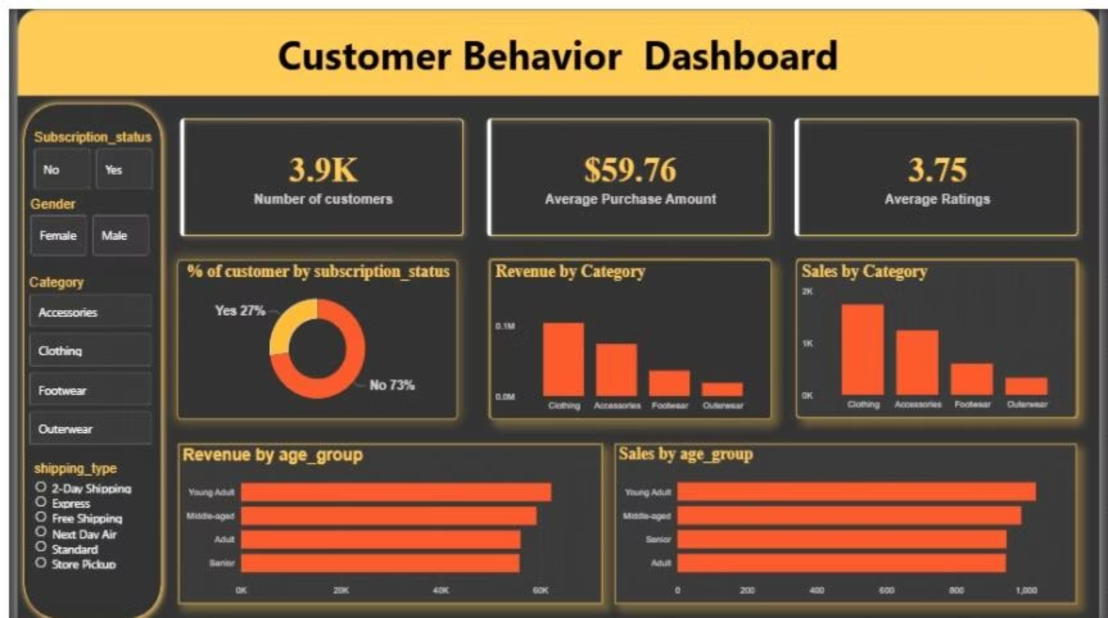
Interactive Dashboard in Power BI
To visualize our findings, an interactive dashboard was developed in Power BI, offering a dynamic and accessible way to explore customer behavior insights.
The "Customer Behavior Dashboard" features a dark theme with striking orange accents, designed for clarity and visual appeal. It includes a comprehensive sidebar for filtering data by subscription status, gender, category, and shipping type, allowing users to drill down into specific segments.
Key metrics such as the number of customers (3.9K), average purchase amount ($59.76), and average ratings (3.75) are prominently displayed. Visualizations include donut charts for subscription status, bar charts for revenue and sales by category, and horizontal bar charts for revenue and sales by age group, providing a holistic view of customer dynamics.

Slide 10

Strategic Business Recommendations
Based on our comprehensive analysis, we propose several key recommendations to optimize business strategies and enhance customer engagement.
Boost Subscriptions
Customer Loyalty Programs
Review Discount Policy
Product Positioning
Promote exclusive benefits and incentives for subscribers to increase conversion and retention rates, leveraging the observed correlation between repeat purchases and subscriptions.
Carefully evaluate the impact of discounts on sales and profit margins. Optimize promotional strategies to balance sales boosts with margin control, especially for discount-dependent products.
Highlight top-rated and best-selling products in marketing campaigns and on the website to capitalize on their popularity and positive customer perception.
Implement robust loyalty programs to reward repeat buyers, encouraging them to transition into the "Loyal" customer segment and fostering long-term relationships.
Targeted Marketing
Focus marketing efforts on high-revenue age groups and customers who prefer express shipping, tailoring messages and offers to resonate with these valuable segments.

